Slide 1
Decision Tree
Ivan Nikolić 15/3241
Prof. Dr. Veljko Milutinović
Pronalaženje skrivenog znanja
Beograd, decembar 2015

Slide 2
Agenda
Problem
Pros and Cons
Implementation

Slide 3
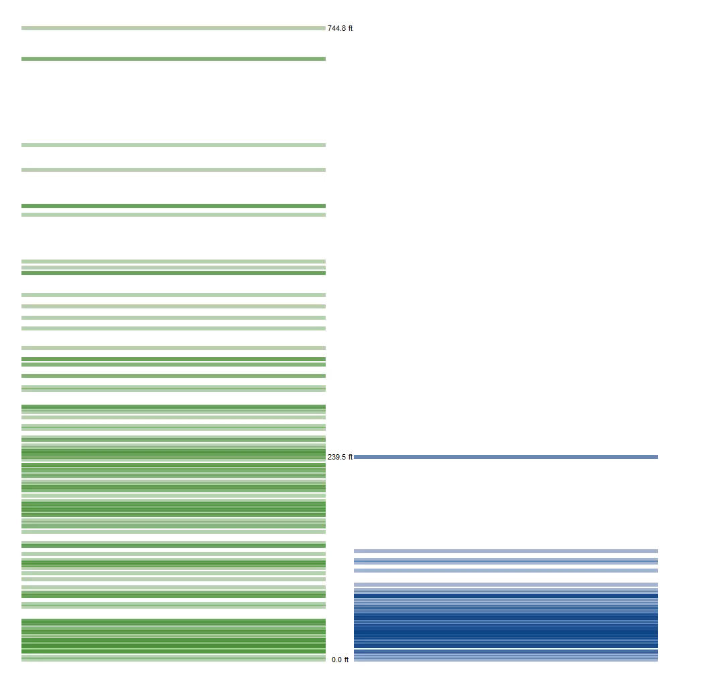
Problem – Data clasification

Slide 4
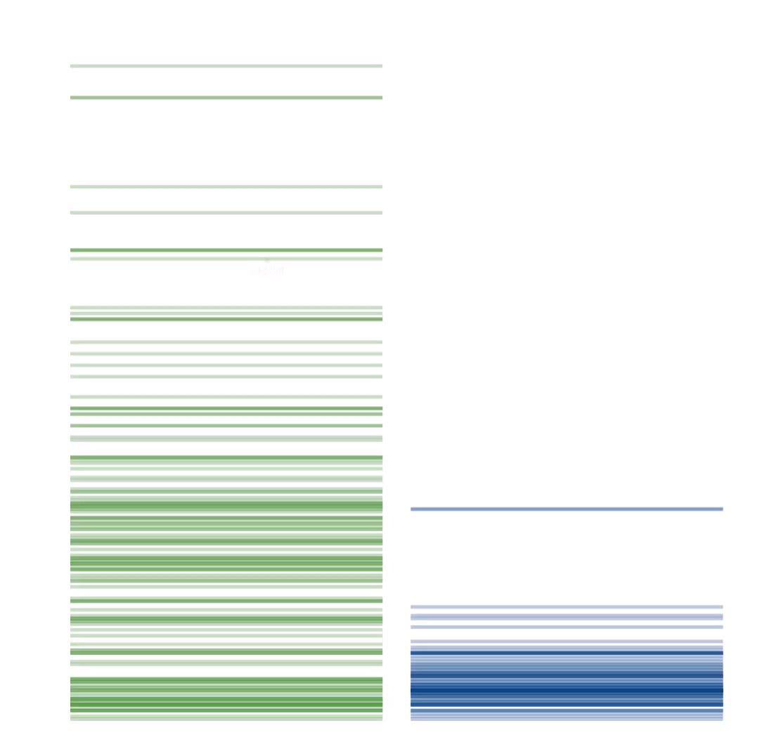
Problem – How to find good boundaries?

Slide 5
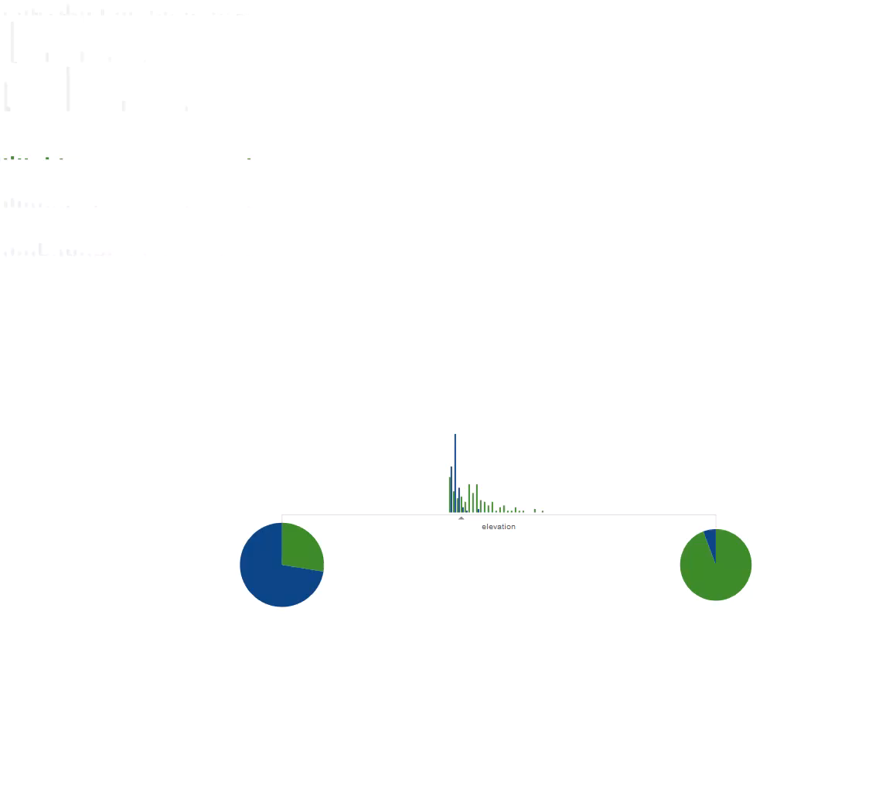
Problem – Decision Tree

Slide 6
Pros Cons
Easy to understand and implement
Good performance
Numeric and discrete values
May be too complex
Optimal tree not guaranteed

Slide 7
Implementation - Basics
Art of implementation lies in good boundaries!
Gini coefficient
Cross entropy

Slide 8
Implementation - Parallelism
Parallel Decision Tree creation
  Parallel split point finder
  Parallel attribute list splitter

Slide 9


Implementation - Results
CPU results
GPU results

Slide 10
Thanks for your attention!
Any questions?

